Slide 1
Cryptography
PU Gujranwala Campus

Slide 2
Cryptography
Cryptography is the science of writing or reading coded messages.
Cryptography comes from the Greek words for “secret writing”
Historically, four groups of people have contributed to the art of cryptography
The military
The diplomatic corps
The diarists
Of these, the military has had the most important role in this field
PU Gujranwala Campus

Slide 3
Encryption and Decryption
Encryption
The process for producing ciphertext from plaintext.
Decryption
The reverse Encryption is called Decryption.
Encryption
Decryption
Plaintext
Plaintext
Ciphertext
PU Gujranwala Campus

Slide 4
Common Cryptography Terms
Plain Text
Original message
The message to be encrypted
Cipher
Secret method of writing (i.e. algorithm)
Key
Plain text is transformed by a function that is parameterized by a key
Some critical information used by the cipher, known only to sender and/or receiver
Ciphertext
Transformed message
The output of the encryption process
PU Gujranwala Campus

Slide 5
Common Cryptography Terms
Intruder
An enemy who hears and accurately copies down the complete ciphertext, can be active or passive
Cryptanalysis
Attempting to discover plaintext or key or both
The art of breaking ciphers
Cryptography
Science of secret writing
The art of devising ciphers
Cryptology
Collection of Cryptanalysis and Cryptography
Study of both cryptography and cryptanalysis
PU Gujranwala Campus

Slide 6
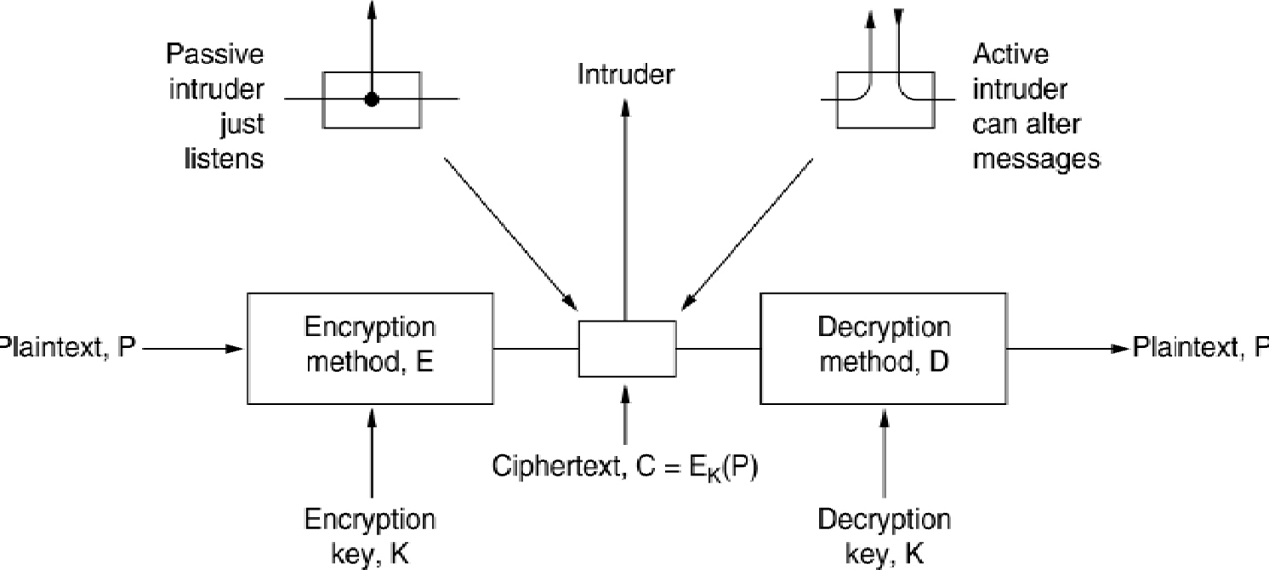
Cryptography
The encryption model
PU Gujranwala Campus

Slide 7
Symbolic Notations for Encryption
C = E_{K}(P)
It means that the encryption of the plaintext P using key K gives ciphertext C
P = D_{K}(C)
It represents the decryption of C to get the plaintext P again.
It then follows that:
DK( (E_{K}(P)) ) = P
Note:
E and D are just mathematical functions
PU Gujranwala Campus

Slide 8
Two major techniques for encryption
Symmetric Encryption
Sender and receiver use same key (shared secret)
Also known as:
Conventional Encryption
Secret Key Encryption
Was the only method used prior to the 1970s
Still most widely used
Public Key (Asymmetric) Encryption
Sender and receiver use different keys
Technique published in 1976
PU Gujranwala Campus

Slide 9
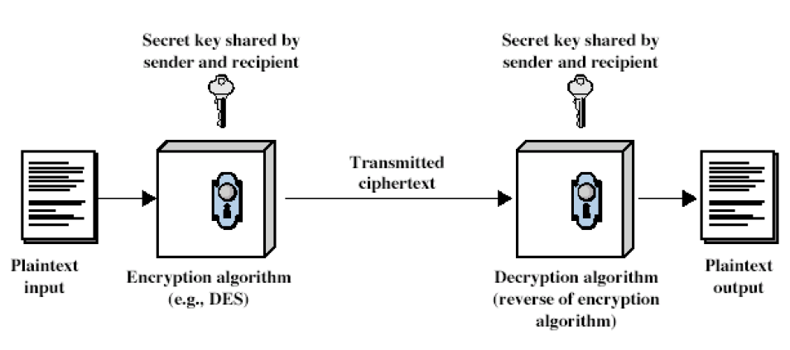
Simplified Model (Symmetric Encryption)
PU Gujranwala Campus

Slide 10
Conventional Encryption Ingredients
An encryption scheme has five ingredients:
Plaintext
Encryption algorithm
Secret Key
Cipher text
Decryption algorithm
Security depends on the secrecy of the key, not the secrecy of the algorithm
PU Gujranwala Campus

Slide 11
Strong Encryption
An encryption algorithm needs to be strong
This means that an attacker who knows:
the algorithm
some pieces of ciphertext
some plaintext-ciphertext pairs (possibly)
cannot deduce:
the plaintext, or
the key
PU Gujranwala Campus

Slide 12
Importance of Secret Key
Every encryption and decryption process has two aspects:
The algorithm
The key used for encryption and decryption
In general, the algorithm used for encryption and decryption processes is usually known to everybody. However, it is the key used for encryption and decryption that makes the process of cryptography secure
The greater the length of the key, the more difficult it will be to break it using brute-force attack
PU Gujranwala Campus

Slide 13
Key
A key is a digital code that can be used to encrypt, decrypt, and sign information.
Some keys are kept private while others are shared and must be distributed in a secure manner.
The area of key management has seen much progress in the past years; this is mainly because it makes key distribution secure and scaleable in an automated fashion.
Important issues with key management are creating and distributing the keys securely.
PU Gujranwala Campus

Slide 14
Importance of the Key
Usually, cryptographic mechanisms use both an algorithm (a mathematical function) and a secret value known as a key.
Most algorithms undergo years of scrutiny by the world's best cryptographers who validate the strength of the algorithm.
The algorithms are widely known and available; it is the key that is kept secret and provides the required security.
PU Gujranwala Campus

Slide 15
Importance of the Key
Analogy of Combination Lock
The key is similar to the combination to a lock. Although the concept of a combination lock is well known, you can't open a combination lock easily without knowing the combination.
In addition, the more numbers a given combination has, the more work must be done to guess the combination---the same is true for cryptographic keys.
The more bits that are in a key, the less susceptible a key is to being compromised by a third party.
PU Gujranwala Campus

Slide 16
Issue of Key Length
The number of bits required in a key to ensure secure encryption in a given environment can be controversial.
The longer the key space---the range of possible values of the key---the more difficult it is to break the key in a brute-force attack.
In a brute-force attack, you apply all combinations of a key to the algorithm until you succeed in deciphering the message.
However, the longer the key, the more computationally expensive the encryption and decryption process can be.
The goal is to make breaking a key "cost" more than the worth of the information the key is protecting.
PU Gujranwala Campus

Slide 17
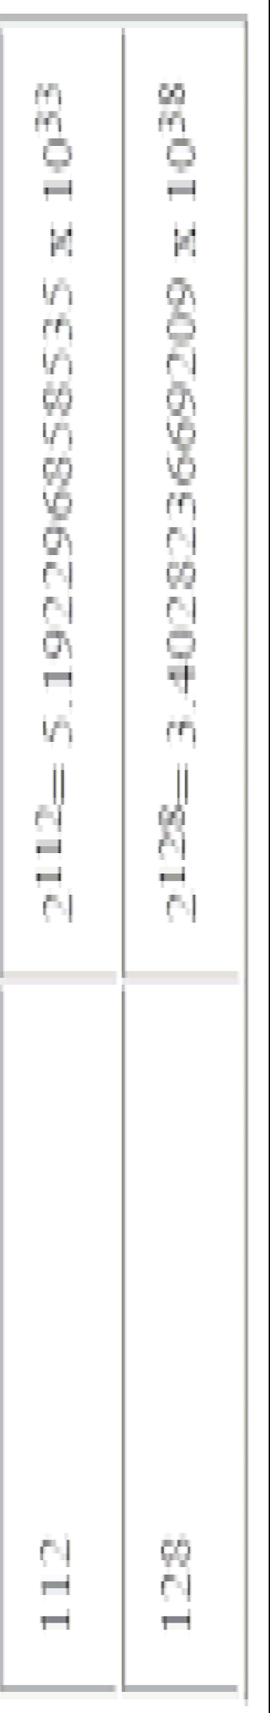
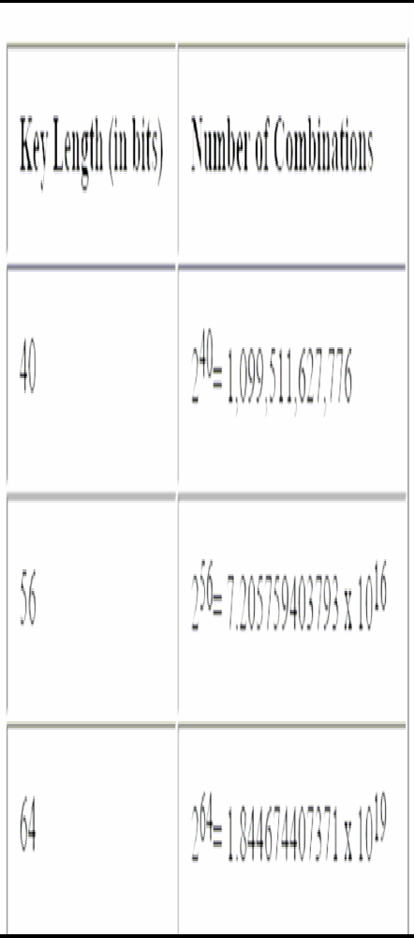
Number of Possible Combinations
PU Gujranwala Campus

Slide 18
Cryptanalysis
Cryptanalysis is the process of trying to find the plaintext or key
Two main approaches
Brute Force
try all possible keys
Exploit weaknesses in the algorithm or key
PU Gujranwala Campus

Slide 19
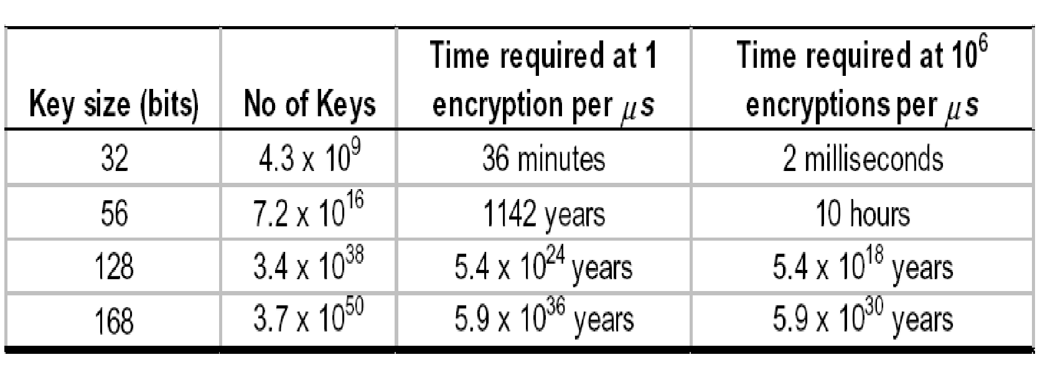
Cryptanalysis: Brute Force Attack
Try all possible keys until code is broken
On average, need to try half of all possible keys
Infeasible if key length is sufficiently long
PU Gujranwala Campus

Slide 20
Three Basic Cryptographic Functions
Cryptography is the basis for all secure communications; it is, therefore, important that you understand three basic cryptographic functions:
Symmetric encryption
Asymmetric encryption
One-way hash functions.
Most current authentication, integrity, and confidentiality technologies are derived from these three cryptographic functions.
PU Gujranwala Campus

Slide 21
Symmetric Key Encryption
Symmetric encryption, often referred to as secret key encryption, uses a common key and the same cryptographic algorithm to scramble and unscramble a message.
Example: Suppose we have two users, Alice and Bob, who want to communicate securely with each other.
Both Alice and Bob have to agree on the same cryptographic algorithm to use for encrypting and decrypting data.
They also have to agree on a common key--- the secret key---to use with their chosen encryption/decryption algorithm.
PU Gujranwala Campus

Slide 22
Symmetric Key Encryption
A simplistic secret key algorithm is the Caesar Cipher.
The Caesar Cipher replaces each letter in the original message with the letter of the alphabet n places further down the alphabet.
The algorithm shifts the letters to the right or left (depending on whether you are encrypting or decrypting).
Figure shows two users, Alice and Bob communicating with a Caesar Cipher where the key, n, is three letters.
PU Gujranwala Campus

Slide 23
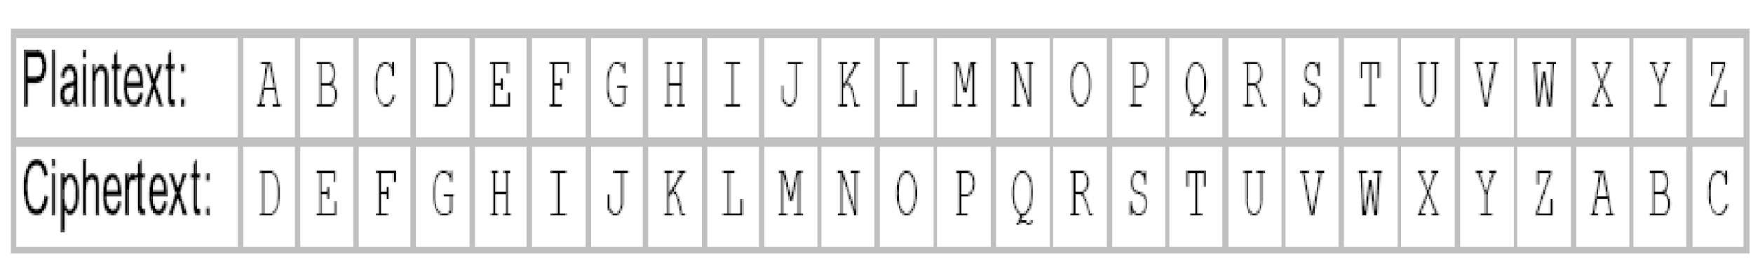
Caesar Cipher
Alphabetic circular shift
For each letter i of text: let pi=0 if letter is a,
and pi=1 if letter is b, etc let key k be the size of the shift
Encryption: ci = Ek(pi) = (pi + k) mod 26
Decryption: pi = Dk(ci) = (ci – k) mod 26
Example (setting k = 3)
attack at dawn
DWWDFN DW GDZQ
PU Gujranwala Campus

Slide 24
Attacking Caesar Cipher
Brute force
Key is just one letter (or number between 1 and 25)
Try all 25 keys
Easy!
PU Gujranwala Campus

Slide 25
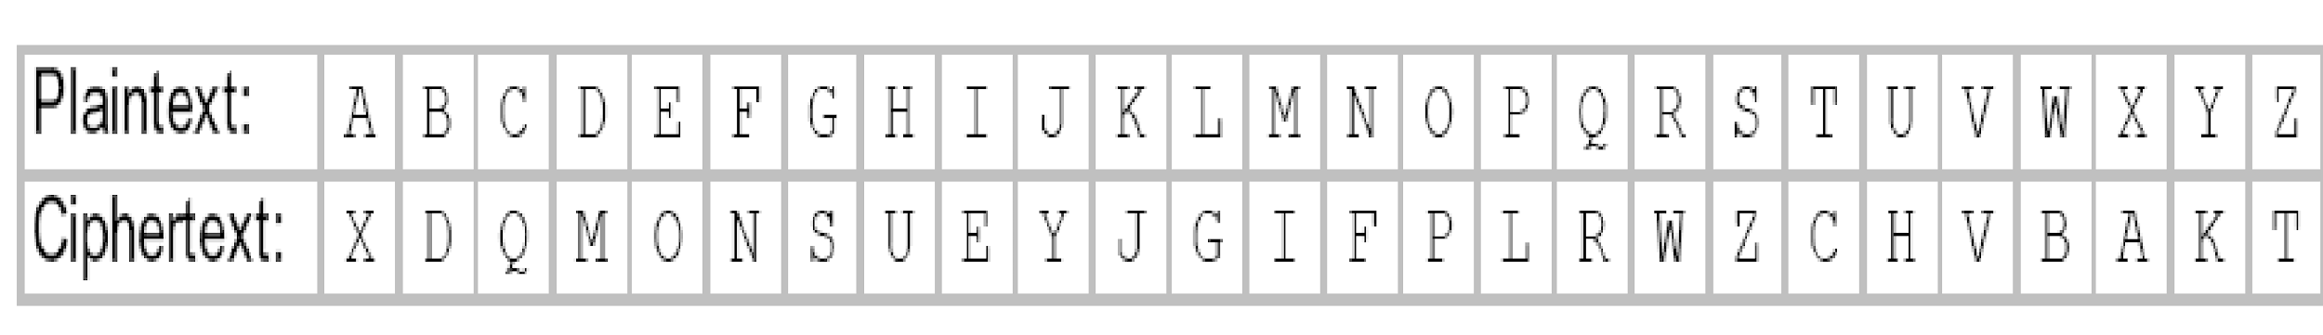
Monoalphabetic substitution
Use arbitrary mapping of plaintext letters onto ciphertext
e.g.
Example:
attack at dawn
XCCXQJ XC MXBF
PU Gujranwala Campus

Slide 26
Attacking Monoalphabetic
Brute force
Very difficult; Key is 26 letters long
No. of possible keys = 26! = 4 x 1026
Algorithm weaknesses:
Frequency of letters in English language is well known
Can deduce plaintext->ciphertext mapping by analysing frequency of occurrence
e.g. on analysing plenty of ciphertext, most frequent letter probably corresponds to ‘E’
Can spot digrams and trigrams
Digram: common 2-letter sequence; e.g. ‘th’, ‘an’, ‘ed’
Trigram: common 3-letter sequence: e.g. ‘ing’, ‘the’, ‘est’
PU Gujranwala Campus

Slide 27
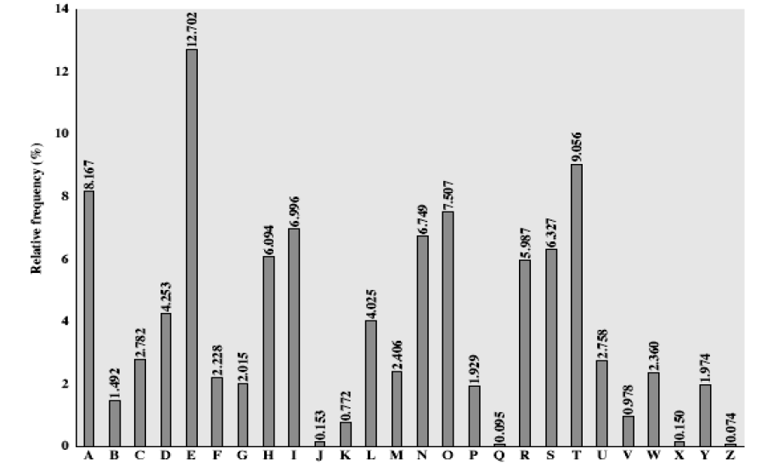
English Letter Frequencies
PU Gujranwala Campus

Slide 28
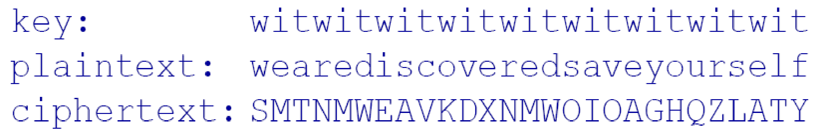
Vigenère Cipher
Set of related monoalphabetic substitution rule is used.
“Add” repeating keyword to plaintext
In effect, 26 Caesar ciphers are used
Example:
PU Gujranwala Campus

Slide 29
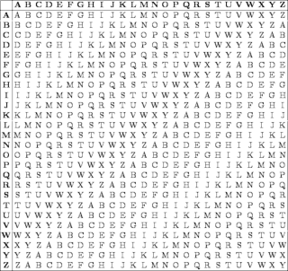
Vigenère Cipher
PU Gujranwala Campus

Slide 30
Attacking Vigenère Cipher
Brute force
More difficult; like password cracking
The longer the key the harder brute force is
PU Gujranwala Campus

Slide 31
One-Time Pads
One-time pad (OTP) is an encryption) is an encryption technique that cannot be cracked) is an encryption technique that cannot be cracked if used correctly. In this technique, a plaintext) is an encryption technique that cannot be cracked if used correctly. In this technique, a plaintext is paired with a random secret key (also referred to as a one-time pad). Then, each bit or character of the plaintext is encrypted by combining it with the corresponding bit or character from the pad using modular addition.
Cipher Text = message + key (mod 26)
PU Gujranwala Campus

Slide 32
One-Time Pads
An OTP is a list of numbers, in completely random order, that is used to encode a message
If the numbers on OTP are truly random and OTP is only used once, then ciphertext provides no mechanism to recover the original key and the message
OTPs are used for short messages and in a very high security environment
PU Gujranwala Campus

Slide 33
One-Time Pad
Uses random key that is as long as the message
Can use key only once One-Time Pad
PU Gujranwala Campus

Slide 34
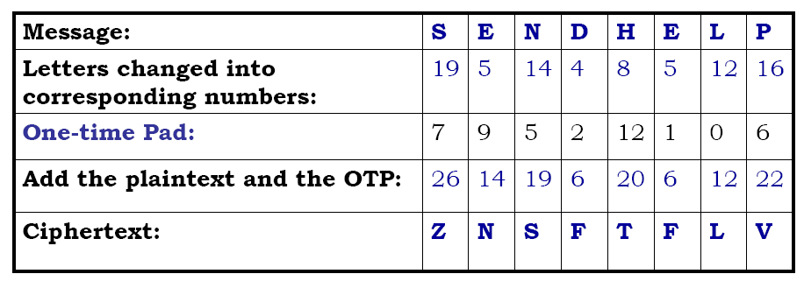
One-Time Pad Operation
PU Gujranwala Campus

Slide 35
One-Time Pads
Problems with OTPs
Generation of truly random one-time pads
Distribution of the one-time pads between communicating entities
Not feasible for use in high-traffic environments
PU Gujranwala Campus

Slide 36
Playfair Cipher
not even the large number of keys in a monoalphabetic cipher provides security
one approach to improving security was to encrypt multiple letters
the Playfair Cipher is an example
invented by Charles Wheatstone in 1854, but named after his friend Baron Playfair
Notes:
‹#›
Symmetric Encryption Technique

Slide 37
Playfair Key Matrix
a 5X5 matrix of letters based on a keyword
fill in letters of keyword (sans duplicates)
fill rest of matrix with other letters
eg. using the keyword MONARCHY
MONAR
CHYBD
EFGIK
LPQST
UVWXZ
Notes:
‹#›
Have here the rules for filling in the 5x5 matrix, L to R, top to bottom, first with keyword after duplicate letters have been removed, and then with the remain letters, with I/J used as a single letter. This example comes from Dorothy Sayer's book "Have His Carcase", in which Lord Peter Wimsey solves this, and describes the use of a probably word attack.

Slide 38
Encrypting and Decrypting
plaintext encrypted two letters at a time:
if a pair is a repeated letter, insert a filler like 'X', eg. "balloon" encrypts as "ba lx lo on"
if both letters fall in the same row, replace each with letter to right (wrapping back to start from end), eg. “ar" encrypts as "RM"
if both letters fall in the same column, replace each with the letter below it (again wrapping to top from bottom), eg. “mu" encrypts to "CM"
otherwise each letter is replaced by the one in its row in the column of the other letter of the pair, eg. “hs" encrypts to "BP", and “ea" to "IM" or "JM" (as desired)
Notes:
‹#›
Note the various rules, and how you wrap from right side back to left, or from bottom back to top. Decrypting of course works exactly in reverse. Can see this by working the example pairs shown, backwards.

Slide 39
Security of the Playfair Cipher
security much improved over monoalphabetic
since have 26 x 26 = 676 digrams
was widely used for many years (eg. US & British military in WW1)
it can be broken, given a few hundred letters
since still has much of plaintext structure

Slide 40
Rail Fence cipher
write message letters out diagonally over a number of rows
then read off cipher row by row
eg. write message out as:
m e m a t r h t g p r y
e t e f e t e o a a t
giving ciphertext
MEMATRHTGPRYETEFETEOAAT
Notes:
‹#›
Example message is: "meet me after the toga party" with a rail fence of depth 2.

Slide 41
Column Transposition Ciphers
G E R M A N d e f e n d t h e e a s t w a l l o f t h e c a s t l e x x
n e d e d f a h t e s e l w t l o a c t f e a h x t s e x l
In a columnar transposition, the message is written out in rows of a fixed length, and then read out again column by column
and the columns are chosen in some scrambled order.
Key: G E R M A N
G E R M A N (326415)
d e f e n d
t h e e a s
t w a l l o
f t h e c a
s t l e x x
Notes:
GERMAN -> 326 415
Assign numbers alphabetically ascending order
‹#›

Slide 42
Column Transposition Ciphers
G E R M A N d e f e n d t h e e a s t w a l l o f t h e c a s t l e x x
n e d e d f a h t e s e l w t l o a c t f e a h x t s e x l
The ciphertext is read off along the columns:
nalcxehwttdttfseeleedsoaxfeahl
A E G M N R (123456)
n e d e d f
a h t e s e
l w t l o a
c t f e a h
x t s e x l
The ciphertext is read off along the columns:
nalcxehwttdttfseeleedsoaxfeahl
Notes:
If any keyword repeats any letter, then first letter will be numbered first and repeating letter will be numbered very next
e.g. ADNAN (1 3 4 2 5)
‹#›

